Slide 1

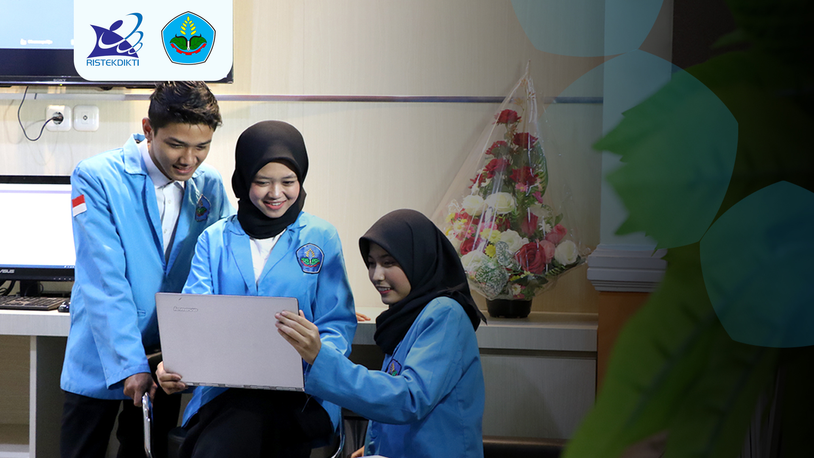



WORKSHOP MOBILE APPLICATIONS FRAMEWORK
Nama : Herawati Putri
NIM : E41241945
Golongan : E
Materi :Flutter-FastAPI-SQLiteBase

Slide 2



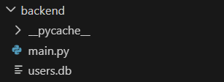
1. Struktur Kode Backend

Slide 3
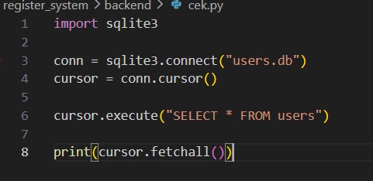
Cek.py

Slide 4
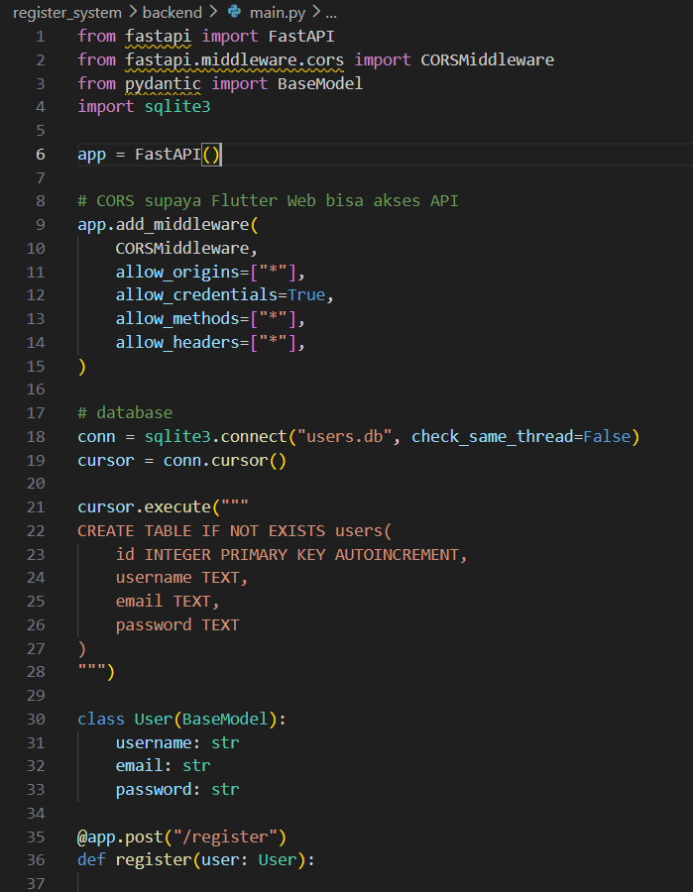
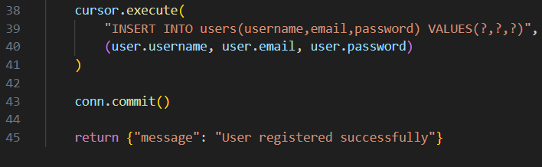
main.py

Slide 5

Cek Nyambung database

Slide 6
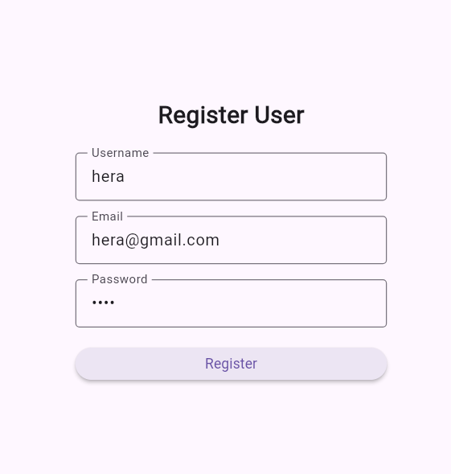
Testing

Slide 7
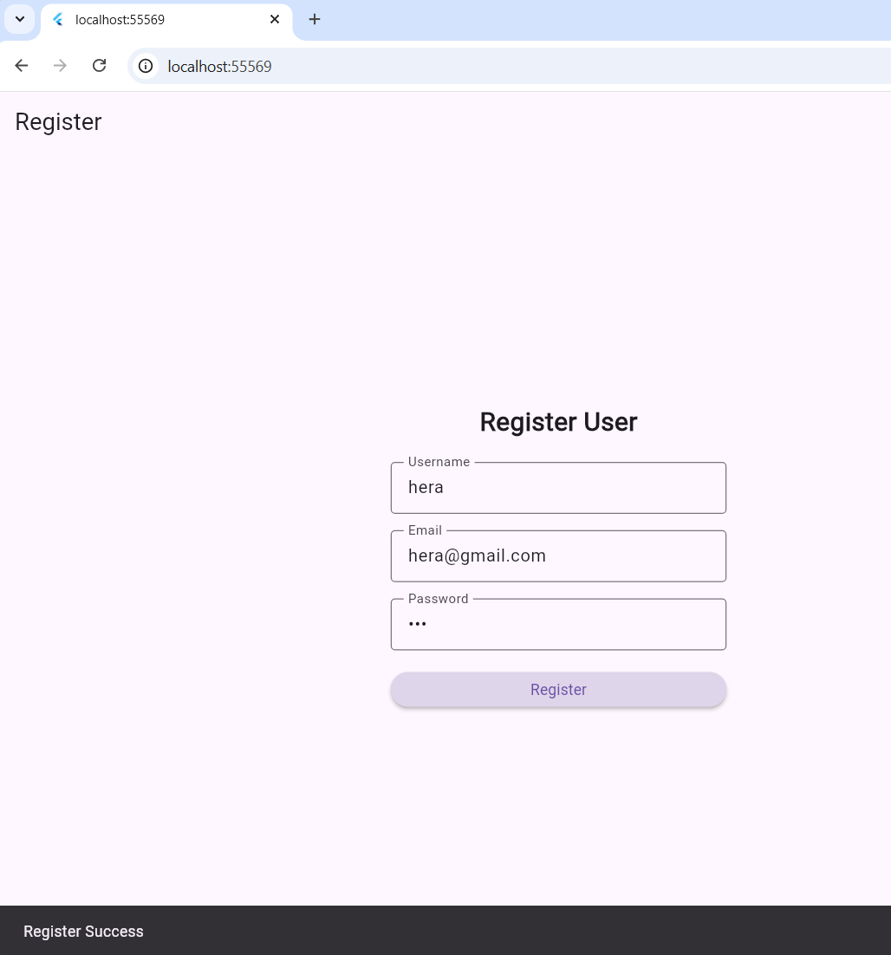
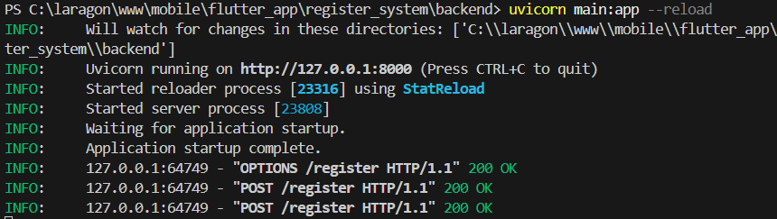
Output

Slide 8

Terima Kasih

